Slide 1

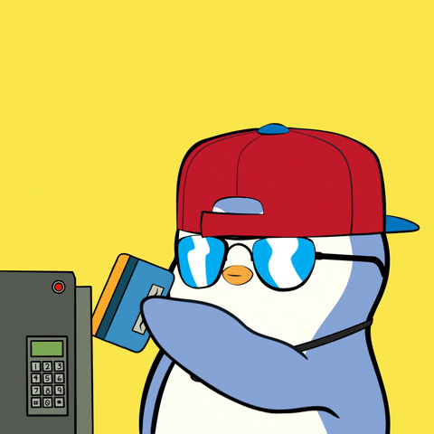



NFTs
PRICING
USING APIs
Anvitha Chaluvadi, Jacqueline Raynolds, and Maria Notarianni

Slide 2

WHY DO PEOPLE BUY NFTS
Collecting and Ownership
Investment
Supporting Artists and Creators
Virtual Identity and Status
Access to Exclusive Content or Experiences
Speculation and Hype
Notes:
Collecting and Ownership:
Just like collecting physical art or collectibles, some people buy NFTs to own a unique digital asset. NFTs represent ownership of a digital item, whether it's digital art, music, virtual real estate, or other digital creations. Owning an NFT can give collectors a sense of ownership and exclusivity.
Investment:
Some people buy NFTs as an investment opportunity. They believe that the value of certain NFTs will increase over time, similar to traditional art or collectibles. Just like investing in stocks, real estate, or cryptocurrencies, buying NFTs can be seen as a way to potentially profit from price appreciation in the future.
Supporting Artists and Creators:
Buying NFTs can be a way to support artists and creators directly. NFTs allow artists to monetize their digital creations in new ways, bypassing traditional intermediaries like galleries or record labels. By purchasing an artist's NFT, collectors can directly support the artist financially and help them continue to create.
Virtual Identity and Status:
In some cases, owning certain NFTs can confer social status or serve as a symbol of identity within virtual communities. For example, owning rare or prestigious NFTs within a specific online community or metaverse can signal status or membership.
Access to Exclusive Content or Experiences:
Some NFTs come with access to exclusive content or experiences. For example, purchasing an NFT might grant access to virtual events, VIP experiences, or special perks within a particular platform or ecosystem.
Speculation and Hype:
Like any emerging market, speculation and hype can also drive demand for NFTs. Some buyers may be attracted to NFTs simply because they see others profiting from them or because they perceive them as trendy or fashionable.

Slide 3

MOTIVATION & SUMMARY
Objective: To assist new NFT buyers in understanding NFT pricing.
Method: Utilizing a linear regression model, evaluating the predictive power of the Pudgy Penguin traits (features) .
Data Source: API data from the Pudgy Penguins collection on OpenSea.
Flexibility: The project could be adapted for other NFT collections.
PM Comment: Reduce features to improve model predictive power! Narrowing the dataset scope can enhance accuracy.
Notes:
We would like to assist NFT buyers who are new to the market and do not understand NFT pricing very well. Buyers will evaluate individual NFTs, using a supervised learning model that has been deployed on Streamlit. We will also include ETH-USD exchange rates as features in the model and components of our analysis.
The project will utilize API data from one NFT the Pudgy Penguins collection on OpenSea; but, in principle, it could be modified and used for other collections by developers.

Slide 4
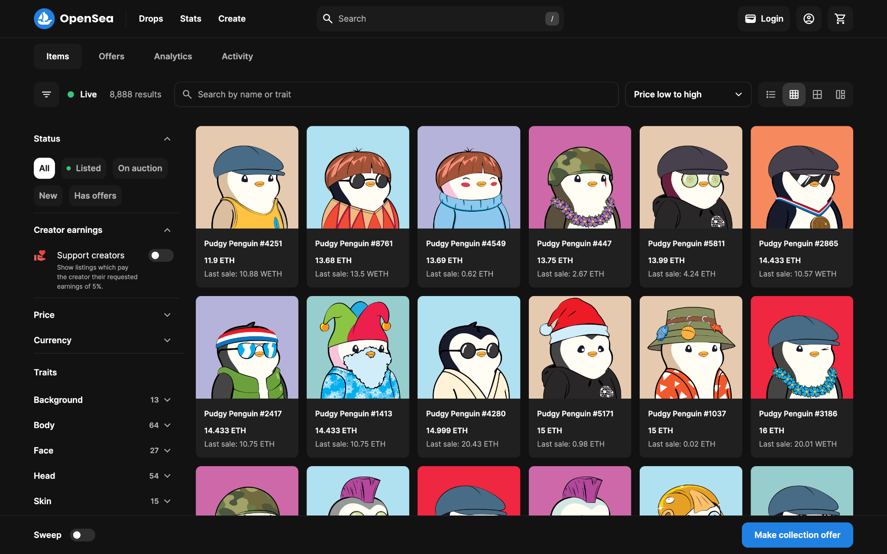
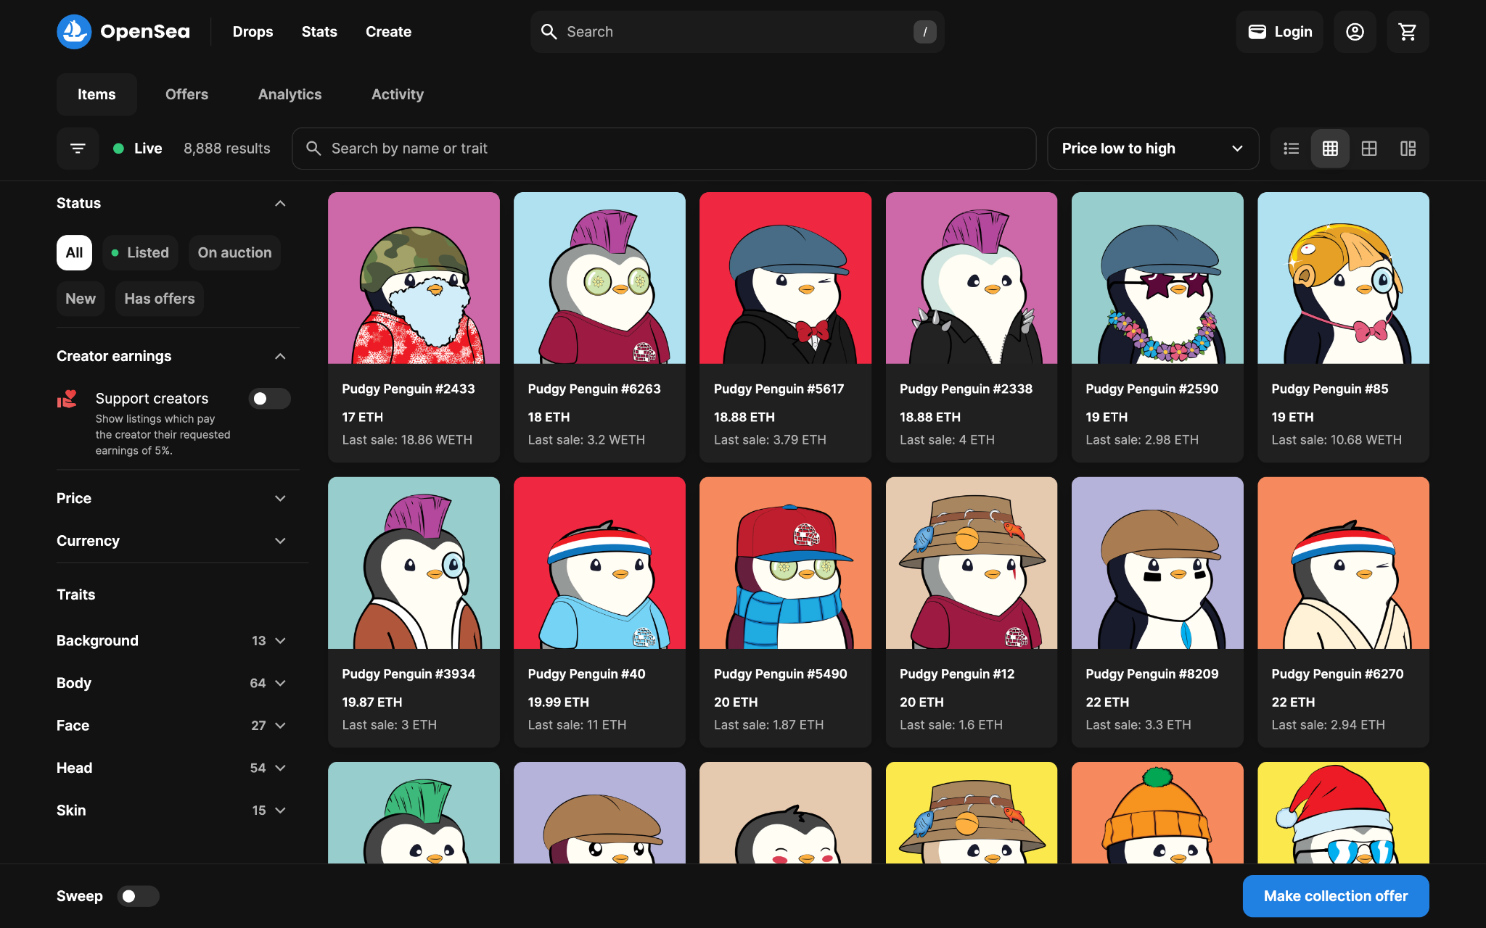

PUDGY PENGUINS
Collection: Pudgy Penguins
Number: 8,888 distinct NFTs
Purpose: Driving Web3 innovation
Values: Representing love, empathy, and positivity
Benefits: Exclusive access to events and experiences for owners
Notes:
Pudgy Penguins is a collection of 8,888 distinct NFTs, driving Web3 innovation through intellectual property and community support. These penguins represent love, empathy, and positivity, offering exclusive benefits to owners, including access to events and experiences.

Slide 5

PUDGY PENGUIN COLLECTION
Volume: 345970.149573
Sales: 78963
Average Price: 4.381421
Number of Owners: 4778
Market Cap: 103268.203657
Floor Price: 12.5 ETH
Floor Price Symbol: ETH
Notes:
background info on collection:
volume sales average_price num_owners market_cap floor_price floor_price_symbol
0 345970.149573 78963 4.381421 4778 103268.203657 12.5 ETH
Let's dive into some key numbers for the Pudgy Penguin collection:
Volume: Over 345,000 transactions have taken place within the Pudgy Penguin ecosystem.
Sales: There have been nearly 79,000 sales of Pudgy Penguin NFTs.
Average Price: Each Pudgy Penguin NFT sells for approximately 4.38 ETH on average.
Number of Owners: Currently, there are 4,778 proud owners of Pudgy Penguin NFTs.
Market Cap: The total market value of the Pudgy Penguin collection is roughly 103,000 ETH.
Floor Price: The minimum price to buy into the Pudgy Penguin collection is set at 12.5 ETH.
Floor Price Symbol: All prices are denoted in ETH, the primary currency of the Pudgy Penguin marketplace.
These numbers give us a snapshot of the activity and value of the Pudgy Penguin NFT collection in the market.

Slide 6
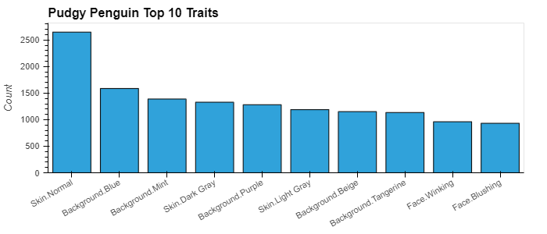

TOP TRAITS
Categories
Background
Skin
Body
Face
Head
Notes:
top 10 traits (and counts)
Skin.Normal 2649
Background.Blue 1587
Background.Mint 1389
Skin.Dark Gray 1329
Background.Purple 1282
Skin.Light Gray 1189
Background.Beige 1152
Background.Tangerine 1135
Face.Winking 961
Face.Blushing 932
top 5 backgrounds traits
Blue 1587.0
Mint 1389.0
Purple 1282.0
Beige 1152.0
Tangerine 1135.0
top 5 skin traits
Normal 2649.0
Dark Gray 1329.0
Light Gray 1189.0
Maroon 731.0
Olive Green 705.0
top 5 body traits
Shirt Blue 290.0
Kimono Brown 268.0
Shirt Red 259.0
Turtleneck Green 254.0
Scarf Green 250.0
top 5 face traits
Winking 961.0
Blushing 932.0
Normal 864.0
Circle Glasses 768.0
Cute 588.0
top 5 head traits
Headband 357.0
Flat Cap Blue 355.0
Bucket Hat Green 349.0
Backwards Hat Red 294.0
Hat Blue 286.0
Alright, let's go over the traits of the Pudgy Penguin collection by category:
In terms of categories, we have Background, Skin, Body, Face, and Head.
Looking at the top 10 traits and their counts, we see some interesting patterns. For example, Skin.Normal is the most common trait, appearing 2,649 times. Background colors like Blue, Mint, and Purple are also quite popular, each appearing over 1,000 times.
Now, let's narrow it down to the top 5 traits in each category:
Background: The top 5 backgrounds are Blue, Mint, Purple, Beige, and Tangerine.
Skin: The most common skin trait is Normal, followed by Dark Gray and Light Gray.
Body: Among body traits, Shirt Blue takes the lead, followed by Kimono Brown and Shirt Red.
Face: When it comes to faces, Winking and Blushing are the top contenders, showing up frequently in the collection.
Head: Finally, in terms of headwear, we see Headband, Flat Cap Blue, and Bucket Hat Green making the top of the list.
These traits give us a glimpse into the diversity and preferences within the Pudgy Penguin collection.

Slide 7


DATA CLEANUP
APIs Integration
Opensea APIs
Traits Summary Counts
NFT Sales Events
Individual NFT Information
Dataframe Components
Events Data
NFT Token (nft.identifier)
Closing Date (for ETH comparison)
Payment Quantity (wei)
Pagination (50 per page)
Individual NFT Info
Traits for Each NFT
Loop Function for Sampling 50 Sales
Exporting Data (static)
to_csv Command
Notes:
We used several APIs to gather essential data for our analysis:
Opensea APIs: These APIs were pivotal in directly accessing data from the Pudgy Penguin collection on OpenSea. They provided us with real-time insights into the collection's dynamics.
Traits Summary Counts: With this API, we obtained summary counts of different traits within the Pudgy Penguin collection. This helped us grasp the distribution of traits among the NFTs.
NFT Sales Events: Using this API, we tracked sales events for the Pudgy Penguin NFTs. It allowed us to monitor the transaction history of individual NFTs.
Individual NFT Information: This API furnished us with detailed information about each individual Pudgy Penguin NFT, including its unique identifier, closing date, payment quantity, and more.
Now, let's discuss the components of our dataframe:
Events Data: This section contained comprehensive details about sales events and transactions.
NFT Token (nft.identifier): We assigned unique identifiers to each Pudgy Penguin NFT.
Closing Date (for ETH comparison): This enabled us to compare prices in ETH by referencing the date of each transaction's closure.
Payment Quantity (wei): We quantified the cryptocurrency payment for each NFT, measured in wei.
Pagination (50 per page): To streamline data management, we structured our data into pages, each comprising 50 sales.
Individual NFT Info: Detailed insights into each Pudgy Penguin NFT were encapsulated here.
Traits for Each NFT: We meticulously cataloged the traits associated with each NFT.
Loop Function for Sampling 50 Sales: A loop function facilitated the systematic sampling of 50 sales at a time, ensuring efficient data collection.
Exporting Data (static): Finally, we exported our data using the to_csv command, generating a static file for further analysis.
Through the seamless integration of APIs and the meticulous organization of dataframe components, we gained profound insights into the intricacies of the Pudgy Penguin collection.

Slide 8
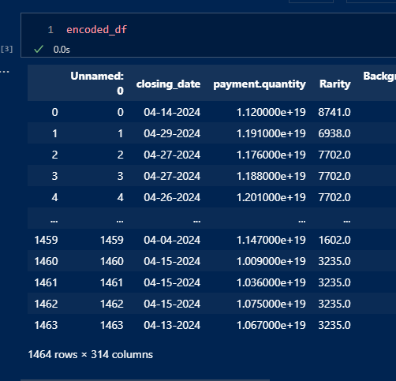

ENCODED DATA

Slide 9

LINEAR REGRESSION MODEL
EVALUATION
R² : “Whereas correlation explains the strength of the relationship between an independent and a dependent variable, R-squared explains the extent to which the variance of one variable explains the variance of the second variable. So, if the R² of a model is 0.50, then approximately half of the observed variation can be explained by the model’s inputs.” (Source: Investopedia)
Training Dataset (Descriptive Value)
R-squared (R²) Score: 0.6909513484448644
This means that traits strongly describes price in training data! (Only 30% noise!)
Testing Dataset (Predictive Value)
R-squared (R²) Score: -1.4725014974827797e+26
This means the model cannot predict anything! But why…?
Notes:
include model type
TT Split info + reasoning
results
datavisualization
what is the y-hat?
The purpose of this code is to calculate and display the evaluation metrics for a linear regression model. These metrics include the Mean Absolute Error (MAE), Mean Squared Error (MSE), Root Mean Squared Error (RMSE), and the R-squared (R²) Score. These metrics help in understanding the model's performance by measuring the difference between the actual and predicted values.
Mean Absolute Error (MAE): the measure of the average absolute errors between the true values and the predicted values. It tells you how close, on average, the predictions are to the true values. In this case, the MAE is approximately 22.34.
Mean Squared Error (MSE): The MSE is a measure of the average squared errors between the true values and the predicted values. It penalizes larger errors more heavily than smaller ones. In this case, the MSE is approximately 114213.79.
Root Mean Squared Error (RMSE): The RMSE is the square root of the MSE. It provides an interpretable measure of the average magnitude of error in the same units as the target variable. In this case, the RMSE is approximately 337.96.
R-squared (R²) Score: The R-squared score, also known as the coefficient of determination, measures the proportion of the variance in the dependent variable that is explained by the independent variables. It ranges from 0 to 1, with higher values indicating a better fit of the model to the data. In this case, the R² score is 1.0, which indicates a perfect fit of the model to the data.
Overall, these metrics provide insights into how well the linear regression model is performing in terms of prediction accuracy and model fit. A lower MAE, MSE, and RMSE, and a higher R² score indicate better performance of the model.

Slide 10
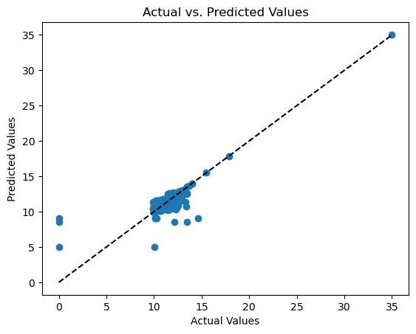
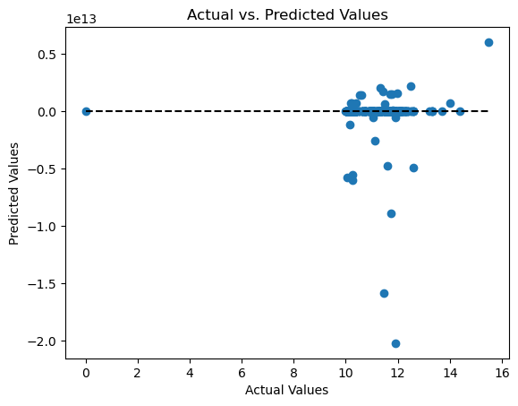

RESULTS
MODEL EVALUATION METRICS
Training Dataset
Testing Dataset
Notes:
The purpose of this code is to calculate and display the evaluation metrics for a linear regression model. These metrics include the Mean Absolute Error (MAE), Mean Squared Error (MSE), Root Mean Squared Error (RMSE), and the R-squared (R²) Score. These metrics help in understanding the model's performance by measuring the difference between the actual and predicted values.
Mean Absolute Error (MAE): the measure of the average absolute errors between the true values and the predicted values. It tells you how close, on average, the predictions are to the true values. In this case, the MAE is approximately 22.34.
Mean Squared Error (MSE): The MSE is a measure of the average squared errors between the true values and the predicted values. It penalizes larger errors more heavily than smaller ones. In this case, the MSE is approximately 114213.79.
Root Mean Squared Error (RMSE): The RMSE is the square root of the MSE. It provides an interpretable measure of the average magnitude of error in the same units as the target variable. In this case, the RMSE is approximately 337.96.
R-squared (R²) Score: The R-squared score, also known as the coefficient of determination, measures the proportion of the variance in the dependent variable that is explained by the independent variables. It ranges from 0 to 1, with higher values indicating a better fit of the model to the data. In this case, the R² score is 1.0, which indicates a perfect fit of the model to the data.
Overall, these metrics provide insights into how well the linear regression model is performing in terms of prediction accuracy and model fit. A lower MAE, MSE, and RMSE, and a higher R² score indicate better performance of the model.

Slide 11
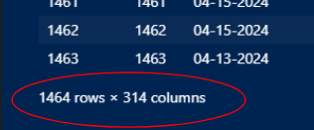

DISCUSSION & POSTMORTEM
Challenges in Model Performance Assessment:
Issue: High dimensionality with limited data points
Ideal Scenario:
Increased dataset size
Reduced feature space
Emphasized need for a significantly larger dataset by Sean
Future Avenues for Solving This Problem:
Converting ETH-USD
Fixing API issues
Isolating traits
Consider focusing on the top 10 traits
Addressing Overfitting:
Attempted PCA feature reduction, but the explained variance ratio was low
Pulling more data to address overfitting in Linear Regression, but conversion fluctuations in ETH-USD impact outcomes
Notes:
Future avenues for solving this problem!
converting ETH-USD
fixing API issues
Isolating traits (maybe top 10 traits?)
We attempted to address overfitting with PCA feature reduction, but the explained variance ratio was very low.
We would pull more data to address LR overfitting, but without the ETH-USD conversion, it would impact outcomes related to big conversion fluctuations in the past year.
Why is the model garbage? Because there are too many features (300+) and limited elements in the dataset (<1500). Ideally, there would be more elements and fewer features. (Sean says MUCH more.)

Slide 12

SHOUT OUTS!

Slide 13

QUESTIONS?

